Slide 1
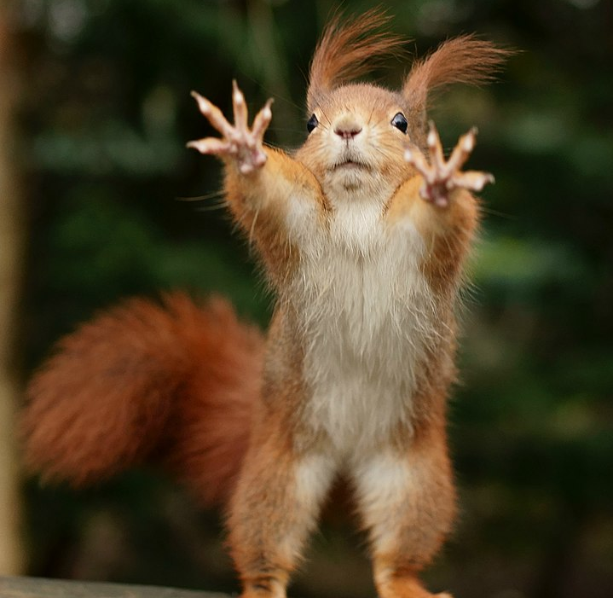
Commercial arbitration case
The famous „Berusconi’s nuts” dispute

Slide 2
Facts of the case
Swindler Stock Corporation, with its registered seat in Budapest, and general manager Mr. Viktor Trickster, claims that it has concluded a sale contract to buy 1000 kg hazelnuts for the price of 5000 euros with Famiglia S.r.l., an Italian company with registered seat in Napoli. At the same time, the Italian company claims that there is only a misunderstanding, there has been no sales contract concluded. There is a hearsay that the Italian company sold „by mistake“ the whole shipment to the Austrians for 7000 euros, thus they are out of stock. The Hungarian company initiated arbitration with the Hungarian Chamber of Commerce and Industry. The Hungarian party has two e-mails, and affidavit (written and signed statements) of the two general managers and two other witnesses.

Slide 3
Exhibit no. 1 (e-mail)
From: Viktor Trickster <swindler@dark.net> Wed, Oct 08, 2020 at 08:36 AM
To: Silvano Berusconi <berusconi@band.it>
Dear Mr. Berusconi,
In accordance with our agreement reached during our personal meeting in Szeged, hereby I order your nuts for the price of 5 euro/kg. Shipment, if it fits you, could happen until 17.11.2020. The usual payment with letter of credit, we have already instructed our bank, branch of OTP on the Cayman Islands, to open a letter of credit for you. One more thing, our lawyer has asked me to send you the arbitration clause that forms part of our contract: „The parties agree that all disputes arising from or in connection with the present contract, its breach, termination, validity or interpretation, shall be exclusively decided by the Court of Arbitration of Hungarian International Chamber of Commerce in accordance with its Rules.“
Best regards,
Viktor Trickster

Slide 4
Exhibit no. 2 (e-mail)
From: Silvano Berusconi <berusconi@band.it> Thu, Oct 22, 2020 at 11:22 PM
To: Viktor Trickster <swidler@dark.net>
Dear Mr. General Manager,
Tomorrow we are going to send the first shipment of your nuts.
Sincerely yours,
Silvano Berusconi

Slide 5
Exhibit no. 3 (The affidavit of the Hungarian company’s manager)
I am Viktor Trickster, the general manager of the Schwindler Stock Corporation with seat in Budapest. Our company was established beginning of nineties, and from that time we have developed serious business relations with Russian, Bissau-Guinean and Balkanic companies. We primarily trade with gas and nuts. This issue with Mr. Berusconi is very inconvenient for me, as till now no single business partner was found who would complain about us.
Getting to the issue, we agreed to meet personally in Szeged in September to discuss the nuts business. I went with my secretary to Szeged on October 6, 2020, where I met Mr. Berusconi personally in the Ritz Carlton. We have agreed that he will ship during August one tone of nuts for 5 euro per kilo. I promised him that our in-house lawyer will draft the details of the agreement, however, even so, both of us considered the agreement final, and we counted with the shipment of those nuts. We have even sent a fax the next day to confirm the agreement. They confirmed the shipment of the merchandise in a reply fax. Based on this, we concluded several contracts with pastry shops. However, as the Italian party did not keep to their obligation, we could not fulfil our contracts, and now our business partners are suing us for breach of contract. Besides, this case has affected our goodwill as well.
Viktor Trickster

Slide 6
Exhibit no. 4 (The affidavit of the Italian company’s manager)
My name is Silvano Berusconi, I am the general manager of Famiglia S.r.l. from Napoli. Our company produces nuts, as well as tobacco. I was approached beginning of August by this company, they were interested in our products. We agreed to meet personally with Mr. Trickster in Szeged. More exactly, it was agreed to meet on October 6, in Hotel Excelsior in Seged. However, when I arrived there, I found a note asking me to go to the Ritz Carlton, they are waiting for me there. I am a serious and well-respected businessman in Napoli, and not used to such things. I was very furious, as a serious businessman, if I agree for the place and time of meeting, I will keep to that. Despite his levity, I went to the other hotel. There I met Mr. Trickster. Honestly, I had the feeling that he was a seriously drunk, but being polite I tried not to notice it. During the negotiations it turned out that they intended to buy a larger amount of nuts from us, but I told them immediately that during October we can sell only a smaller shipment, about five to six kilos, purely for marketing reasons, because we have had already sold the stock to the Austrians. Mr. Trickster grizzled for a while, or it might be that it only seemed to me because he was very drunk, so at the end he understood that we do not have the quantity he wanted to buy. During the negotiations I had the feeling that he already committed himself to somebody that he will procure one ton of nuts, and that was the reason why it was so important for him.

Slide 7
Exhibit no. 5 (The affidavit of the Hungarian company’s secretary)
I accompanied my boss on October 6, 2020 to Szeged. As usual we lodged in the Ritz. But to be honest, I like more Hotel Forrás, because there is a cosmetic salon with laser wrinkle removal. The boss ordered for me a bunch of roses, of course only for representative reasons. After the lunch we had a champagne, of course only for representative reasons, to show that we are representing a serious company. Following this, the boss asked me to leave a message for the Italians to come to our hotel at three pm, and after doing this, to go to his room because he wanted to dictate a short cutey business letter.
I am afraid, I was not present at the negotiations, as I was doing some research for our marketing department in the new Szeged Plaza. But immediately following this, I talked to my boss, who told me, I remember well: „excellent, we have concluded the contract“. I would like only to add that my boss is a real gentleman, who always keeps his word. He is a real man.
Ruby Rubacuori

Slide 8
Exhibit no. 6 (The affidavit of the Italian company’s driver)
My name is Luciano Camorra. I work for the Family from 2005 as personal driver of the boss. I remember well that sunny day when we departed for Segeed, as we had a minor problem on the border with the new Audi we purchased few months ago. There was a minor problem with the engine number, but we could solve it within few hours. We arrived around 2 pm to Seged. My boss had to meet the general manager of the Hungarian company in the Excelsior, but we only found a message there, saying that he is waiting for my boss at 3 pm in the Ritz Carlton. Thus, we went there. I left my boss at the hotel, and went for a coffee to the nearby coffee house, as my blood pressure fell a bit till then. After the coffee, I went to the nearby Bosorkanjtanja massage salon. It was around five when I got a call from my boss to pick him up. After picking him up at the hotel, I asked him if the negotiations were successful, but he answered me very angrily, telling me that this was a terrible drunkard, I mean fellow, and there was no business concluded. However, he decided to send him few kilos of nuts to show the quality of the Italian nuts. Following the exhausting negotiations, the boss also wanted to have some massage. We departed back to Napoli around eight, but before my boss bought some golden earrings for his wife, to show her how much he loves her.

Slide 9
Your task
Please, write a request for arbitration (the Hungarian party being the claimant). The request should contain the following:
the name in full, description, address and other contact details of each of the parties,
the name in full, address and other contact details of any person(s) representing the Claimant in the arbitration,
a description of the nature and circumstances of the dispute giving rise to the claims and of the basis upon which the claims are made,
a statement of the relief sought, together with the amounts of any quantified claims and, to the extent possible, an estimate of the monetary value of any other claims,
any relevant agreements and, in particular, the arbitration agreement(s),
nomination of the arbitrator
other proposals.

Slide 10
Helpful sources
You should examine relevant provisions of the Vienna Convention
You should study commentaries on these provisions (http://cisgw3.law.pace.edu/ - free registration needed)
You should research the related case law (http://cisgw3.law.pace.edu/)
You should study the Rules of Proceedings of the Arbitration Court attached to the Hungarian Chamber of Commerce and Industry (https://mkik.hu/en/court-of-arbitration)
the Hungarian Act LX of 2017 on Arbitration (https://mkik.hu/en/court-of-arbitration)

Slide 11
Please, think about the following when writing the request for arbitration:
What will be the arguments of the other party:
regarding the validity of the arbitration agreement,
jurisdiction of the arbitral tribunal,
formation of the sales contract under the Vienna Convention,
damages claimed, etc.

Slide 12
The creation of distance learning materials was supported by the Ministry of Justice within the framework of the IM KOP 2020 aiming at the improvement of legal education.
A távoktatási segédletek az Igazságügyi Minisztérium jogászképzés színvonalának emelését célzó programja keretében valósultak meg.
(IM KOP 2020)
ALCÍM
„Vitam impendere vero”

