Slide 1
Introduction to the Comparative Entertainment Law
Dr. István Harkai PhD, Assistant Lecturer
University of Szeged Faculty of Law and Political Sciences
Institute of Comparative Law and Legal Theory

Slide 2
Right of publicity – overlap or frontier with intellectual property rights?
COPYRIGHT & RELATED RIGHTS: ECONOMIC & MORAL RIGHTS | TRADEMARK | RIGHT OF PUBLICITY/PRIVACY
Protected subject matters: - Dramatic or dramatico musical; choreographic works→performers - Photographic works (Article 4 Berne Convention.) Moral Rights: Making the work public -Indication of the author’s name -Protection of the integrity of the work. Economic rights: reproduction, distribution, public performance, communication to the public, adaptation, exhibition. | (…) any signs [capable of being represented graphically],* in particular words, including personal names or designs, letters, numerals, colours, the shape of goods or the packaging of goods, or sounds, provided that such signs are capable of distinguishing the goods or services of one undertaking from those of other undertaking (…) (Art 3 of Directive 2015/2436.) (*Art 2 of Directive 2008/95/EC.) | Basic Law of Germany § 1-2: Human dignity – Human rights Personal freedoms (develop his personality). Code Civil of France § 9. Italy and Spain – Basic Law Swiss Civil Code §28. Sweden – Act of 1979 on the names and images placed in commercial advertisement

Slide 3
Right of publicity – an overlap with intellectual property rights?
INTELLECTUAL PROPERTY RIGHTS | RIGHT OF PUBLICITY – IMAGE RIGHTS
Absolute Rights Protected Subject Matter: creation of the human mind. | Absolute Rights Protected Subject Matter: Image, appearance, voice, publicity („fame”).
COMMERCIAL VALUE

Slide 4
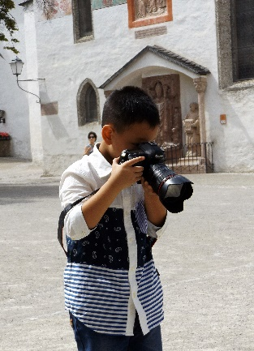
Photographs vs images
Making photograph: freedom of expression; economic interest in the picture
Right of privacy/publicity of the person in the picture: personal rights; economic interest in the picture.

Slide 5
Sport related aspects of the right of publicity
Sport branch provides 2% of the total GDP of the European Union.
7,3% of the total number of empolyees working in the sport sector.
Biggest stars make a fortune not only from their sport contracts but from advertisement businesses.
Brand of CR7:
190 Million Pound income in 2015. 20 Million was subject to tax in Spain.
The rest 170 Million Pound was related to advertising activities and kept in a bank account located in the British Virgin Islands (tax paradise!).
Advertising companies using CR7 image: Nike, Armani, Tag Heuer, Castroll.

Slide 6
Right of publicity in the common law countries I
United Kingdom | United States of America
There is no specific regulation regarding the right of publicity. | Right of Publicity: protects the economic and moral interests of a person.
Rules on TM and Passing off (protects the goodwill of a trader from misrepresentation in case of unregistered trademarks.). The „Guernsey-solution”: image rights contain a person’s name, voice, signature, likeness, appearance. Transferable economic and personal rights. Image rights can be registered, which provides protection for three years. | Protection is different from state to state. California, Florida, Indiana, Illinois, Kentucky, Massachusetts, New York, Nebraska, Nevada, Ohio, Oklahoma, Pennsylvania, Rhode Island, Tennessee, Texas, Utah, Virginia, Washington, Wisconsin have their own act. In other member states it is regulated by the common law. First cases were dismissed based on the assumption that the celebrities appeared before the public willingly, so that they gave permission to the use of their likeness.

Slide 7
Right of publicity in the common law countries II
Haelan Laboratories, Inc. v. Topps Chewing Gum, Inc, 202 F.2d 866 (2d Cir. 1953): defendant invaded plaintiff's exclusive right to use the photographs of leading baseball-players.
The Court recognized the right of publicity, which was in addition to the right to privacy, and this right to publication of a picture could have been subject to exclusive rights contracts under New York law.
Interpretation of the right of publicity after the decision:
A person is entitled to commercially exploit his own image.
Protection of personhood stimulates creativity.
Regulation of the right of publicity protects the consumers as well.
Notes:
FACTS: Haelan Laboratories, Inc. (“Haelan”) and baseball players entered into contracts that provided Haelan with the exclusive right to use the players' photographs in connection with Haelan's gum sales. The players were not to grant any other gum manufacturer a similar right during such term, and Haelan had an option to extend the term. Topps Chewing Gum, Inc. (“Topps”) induced the players to enter into contracts that authorized Topps to use the players' photographs in connection with sales of Topps’ gum either during the original or extended term of Haelan's contracts. Topps then used the players' photographs. Haelen filed a complaint against Topps alleging that it had induced a sports figure to breach his contract allowing Haelen the exclusive right to market his photograph. The district court dismissed Haelan’s complaint and Haelan appealed.
CONCLUSION: The Court reversed the district court's dismissal and remanded the matter to the district court for a determination of the date and contents of each of Haelan’s contracts, whether Haelan exercised its option to renew, and of Topps’ or its agent's conduct with respect to each such contract. Further, Topps was not liable for any breach induced by a non-agent. The Court recognized the right of publicity, which was in addition to the right to privacy, and this right to publication of a picture could have been subject to exclusive rights contracts under New York law.

Slide 8
Right of publicity in the common law countries II – limitations on the right of publicity? – rogers-test
U.S. Constitution Amendment I: Congress shall make no law respecting an establishment of religion or prohibiting the free exercise thereof; or abridging the freedom of speech, or of the press; or the right of the people peaceably to assemble, and to petition the government for a redress of grievances.
Transformative Use Test: altering the original with new expression, meaning, or message?
Rogers Test: Rogers v Grimaldi, 875 F. 2d 994 (2d Cir. 1989.).
Ginger Rogers sued Alberto Grimaldi for production and distribution of the 1986 Federico Fellini film Ginger and Fred, a film about Pippo and Amelia, two Italian cabaret performers whose routine emulated the more famous pairing of Fred Astaire and Ginger Rogers. Rogers claimed that the film violated her Lanham Act trademark rights, right of publicity, and was a "false light" defamation.
Court had to decide whether Rogers can prevent the use of the title Ginger and Fred for a fictional movie that only obliquely relates to Rogers and Astaire."
Judge Jon O. Newman: "suppressing an artistically relevant though ambiguously titled film" on trademark grounds would "unduly restrict expression." [Rogers, 875 F.2d at 1001.]
Decision of the 2nd Circuit (the Rogers Test itself): section 43(a) of the Lanham Act does not bar a minimally relevant use of a celebrity's name in the title of an artistic work where the title does not explicitly denote authorship, sponsorship, or endorsement by the celebrity or explicitly mislead as to content.” [Rogers, 875 F.2d at 1005.]

Slide 9
Right of publicity in the common law countries II – limitations on the right of publicity?
E.s.s. Entm't 2000, Inc. v. Rock Star Videos, Inc. 547 F.3d 1095 (9th Cir. 2008):
Plaintiff ESS Entertainment 2000, Inc. ("ESS"), operates a strip club, which features females dancing nude, called Play Pen. ESS claims that defendant Rockstar Games Inc., manufacturer and distributor of the Grand Theft Auto series of video games, has a game which used Play Pen's distinctive logo and trade dress without its authorization and has created a likelihood of confusion among consumers as to whether ESS has endorsed, or is associated with, the video depiction. The district court granted summary judgment in favor of defendant video game manufacturer, holding that a video game's depiction of an animated strip club called the "Pig Pen" did not infringe upon the trade mark or the trade dress of the operator's club. On appeal, the court affirmed the grant of summary judgment.
Courts to construe the Lanham Act to apply to artistic works only where the public interest in avoiding consumer confusion outweighs the public interest in free expression. An artistic work's use of a trademark that otherwise would violate the Lanham Act is not actionable unless the use of the mark has no artistic relevance to the underlying work whatsoever, or, if it has some artistic relevance, unless it explicitly misleads as to the source or the content of the work.

Slide 10
Right of publicity in the common law countries II – limitations on the right of publicity? – Predominant use test
Predominant Use Test: Doe v. TCI Cablevision 110 S.W.3d 363 (Mo. 2003).
Anthony “Tony” Twist is a former professional hockey player in the National Hockey League. TCI Cablevision (TCI) created, published, and marketed a comic book titled “Spawn” which contained a villainous character sharing Twist’s name. Both the real and fictional Tony Twist were characterized by having a “tough guy” persona, but other than that shared no resemblance. In two interviews, however, the creator of “Spawn” said that the fictional villain was based on the real Tony Twist. Twist brought suit against TCI for misappropriation of name and defamation. At trial, Twist introduced evidence that the fictional character was based on him, and that TCI gained financial benefits by marketing the “Spawn” comic book to hockey fans, Twist’s fan base. TCI defended on the grounds that it did not base the fictional villain on Twist, that it received no financial benefit, and that its actions were protected by the First Amendment.
On review, the supreme court determined that the athlete's case was more precisely labeled a right of publicity action. Although the comic book character was not about the athlete, he maintained that the sharing of the same name and the common persona of a tough-guy "enforcer" created an unmistakable correlation between himself and the comic book character, which established that the creators used his name and identity.
Notes:
Facts
Anthony “Tony” Twist (plaintiff) is a former professional hockey player in the National Hockey League. TCI Cablevision (TCI) (defendant) created, published, and marketed a comic book titled “Spawn” which contained a villainous character sharing Twist’s name. Both the real and fictional Tony Twist were characterized by having a “tough guy” persona, but other than that shared no resemblance. In two interviews, however, the creator of “Spawn” said that the fictional villain was based on the real Tony Twist, the professional hockey player. Twist brought suit against TCI for misappropriation of name and defamation. He sought to recover damages for the fair market value TCI should have paid him to use his name in connection with “Spawn” products, and the damage done to the endorsement value of his name by having it connected with a villainous character. At trial, Twist introduced evidence that the fictional character was based on him, and that TCI gained financial benefits by marketing the “Spawn” comic book to hockey fans, Twist’s fan base. TCI defended on the grounds that it did not base the fictional villain on Twist, that it received no financial benefit, and that its actions were protected by the First Amendment. The trial court dismissed the defamation count, but sustained Twist’s misappropriation of name claim. The jury awarded him $24,500,000 in damages. However, the trial judge granted judgment notwithstanding the verdict for TCI, and ordered a new trial in the event its judgment notwithstanding the verdict was overturned. The Missouri Supreme Court heard the case.

Slide 11
Irvine and Rihanna
Irvine v Talksport [2002] EWHC 367.
Talksport used Irvine’s image withouth authorisation for his own advertising purposes and also modified the original picture by mounting a radio into Irvin’s hand. → Use of Irvine’s image without authorisation was unlawful and was a ground for passing off.
Fenty & Ors v Arcadia Group Brands Ltd (t/a Topshop) [2015] EWCA Civ 3.
Topshop used Rihanna’s portray on their t-shirts. They asked permission from the author of the photographs but not from Rihanna. Rihanna sued for TM infringement and passing off. The advertisement furthermore was misleading because it made the consumers think that the t-shirt is related to Rihanna’s new album, River Island hurting its good will.

Slide 12
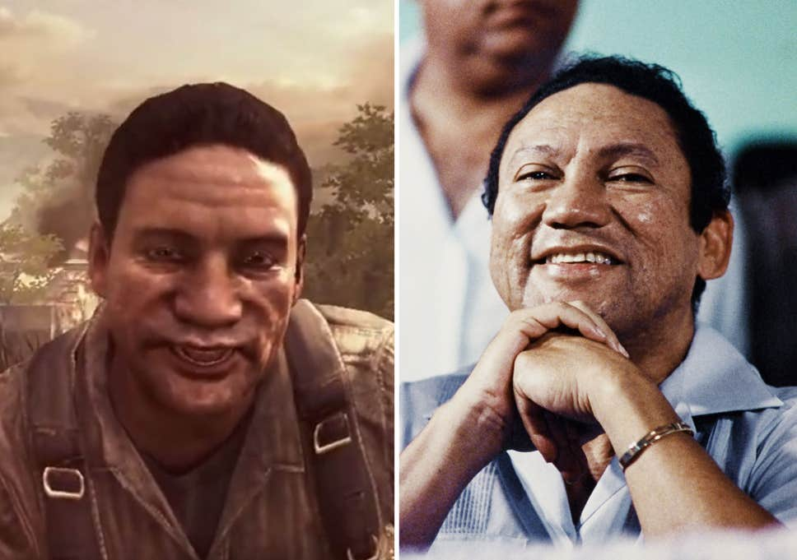
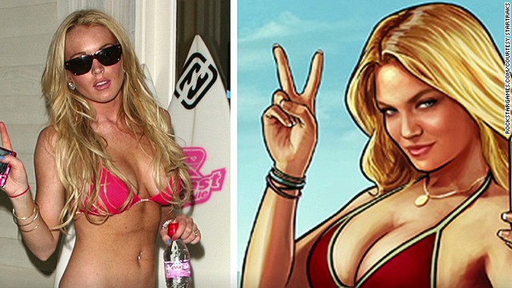
Image rights in computer games
Notes:
https://cdn.cnn.com/cnnnext/dam/assets/140703132044-lv-lohan-sues-grand-theft-auto-00024714-story-top.jpg
https://encrypted-tbn0.gstatic.com/images?q=tbn%3AANd9GcQYVRrDolAXdcbfABv0Kl2hxjA4i07heDOeOQ&usqp=CAU

Slide 13
Keller v Electronic Arts, No. 10-15387, 2013 WL 3928293 (C.A.9), (July 31, 2013).
Keller American football player played as a defender for the Arizona and Nebraska state universities.
EA used Keller's and others likenesses and other physical appearances in its NCAA Football Game. According to the defendant the use fell under the scope transformative use test.
Court refused the transformative use test defense based on the fact that the emphasize in the game was on the physical appearance of the players to make the game as realistic as possible.
The Court than examined whether the protection of the freedom of press or the right to information. The court argued that the statistical data of the players can be used for such purposes as making the game more realistic. BUT the use cannot supersede the mere use of statistic data.
The outcome was a settlement: the EA paid 60 Million Dollars for the use of the image rights of the plaintiffs.

Slide 14
Hart v Electronic Arts, No.: 09-cv-5990 (FLW)
Ryan Hart was a defender in the Rutgers University football team. EA used his lookalike and his personal appearance in its game.
The first instance decided the case in favor of EA based on the First Amendment of the US Constitution (free speech and the freedom of the press).
The second instance changed the decision of the first one reasoning that when the right of publicity collide with the two fundamental rights of the First Amendment, they might be limited and the right of publicity shall prevail.

Slide 15
Oliver Kahn „gegen” EA
EA asked for permission to use the images and personal appearance as well as statistics of European football players in order to make its game Fifa World Cup 2002 much more realistic.
Oliver Kahn, the goalkeeper of the German national football team and the Bayern München wasn't asked personally for permission, which permission was granted on the other hand by the FIFPro, the representative body of the professional football players and from the German Football Federation (Deutscher Fußball-Bund).
The court decided the case in favor of the plaintiff due to the infringement of his image rights and ordered the game to be withdrawn from the German market.

Slide 16
Thank you for your attention
Harkai István (harkai.istvan89@gmail.com; harkai.istvan@juris.u-szeged.hu)
Blog: Copy 21 (http://copy21.com/).
This teaching material has been made at the University of Szeged, and supported by the European Union by the project nr. EFOP-3.6.2-16-2017-00007, titled Aspects on the development of intelligent, sustainable and inclusive society: social, technological, innovation networks in employment and digital economy. The project has been supported by the European Union, co-financed by the European Social Fund and the budget of Hungary.

