Slide 1
Introduction to the Comparative Entertainment Law
Dr. István Harkai PhD, Assistant Lecturer
University of Szeged Faculty of Law and Political Sciences
Institute of Comparative Law and Legal Theory

Slide 2
Law on the actors of creative industry Comparative perspective
ORIGINALITY (Creative and original works in the field of literature, science or art.
Starting point of the protection: At the moment of the creation or at the moment of the fixation?
It does not depend on value judgement. (See: techno [SZJSZT 43/2000].)
Notes:
https://hu.pinterest.com/pin/677791812644517247/

Slide 3
Excluded from protection
Idea, principle, concept, procedure, mathematical operations are not protected!
Folklore? Traditional dances, cultural heritage?
BUT!
Folksong: public domain.
Singing a folksong: performance.
Fixation of a folksong: phonogram producer.
Using folksong for other purposes, such as a new choreography: adaptation? (See: Kodály: Székelyfonó, Esti dal).
Notes:
https://i.quotev.com/img/q/u/19/4/17/o7yffdmwxy.jpg

Slide 4
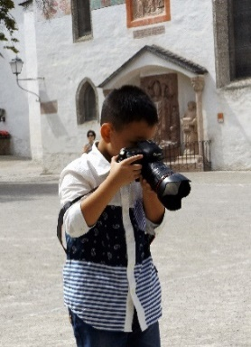
Types of works
Literary works,
Public speeches,
Computer program creations,
Plays, musicals, ballets and pantomimes,
Musical works with or without lyrics,
Radio and television plays,
Cinematographic creations and other audio-visual works.
Creations produced by drawing, painting, sculpturing, engraving, lithography,
Photographic works,
Maps and other cartographic creations,
Architectural works and plans,
Designs for engineering structures,
Applied art creations and design,
Costume, scenery and designs,
Industrial design creation,
Databases qualifying as collection of works.

Slide 5
Economic rights of related right holders
Fixation of unfixed performance, phonograms, broadcasted programs, motion pictures.
Broadcast or other type of communication to the public of unfixed performances, phonograms, broadcasted programs, motion pictures.
Reproduction of fixed performances, phonograms, broadcasted programs, motion pictures.
Distribution of fixed performances, phonograms, broadcasted programs, motion pictures.
On-demand communication to the public of fixed performances, phonograms, broadcasted programs, motion pictures. (Stream.)

Slide 6
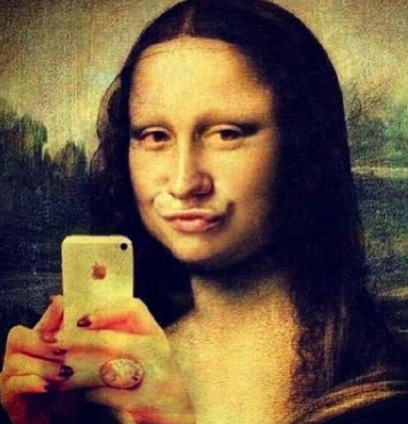
Moral rights
Making the work public.
Indication of the author’s name.
Protection of the integrity of the work.
Moral rights are non-transferable, non-waivable.
Notes:
https://i.pinimg.com/564x/d9/db/e7/d9dbe79cd4a467d66c20b7308115afff.jpg

Slide 7
Economic rights of copyright
Exclusive right of exploitation, use and the authorisation of the use in return of royalty.
Right of reproduction,
Right of distribution,
Right of performance,
Communication to the public,
Right of adaptation,
Right of exhibition.

Slide 8
Limitations & exceptions
Free use of the work,
Shall not be subject to the payment of remuneration and any authorisation of the author.
Only works made public may be used freely.

Slide 9
Cases of the free use
Quotation (with indication of the source),
Private copying (none commercial reproduction),
Temporary acts of reproduction,
Illustration for school education and scientific research,
Publicly presented lectures, political speeches for the purpose of information.
Articles published on current economic or political topics or works broadcast on the same topic may be reproduced and communicated to the public.
Any fine art, photographic, architectural, applied art or industrial design creation may be freely used as scenery in audio-visual media services.
Certain works maybe used freely for the purpose of providing information on current events to the extent justified by the purpose.
In court, administrative and other official proceedings a work may be used for purposes of evidence.

Slide 10
Relationship Between Copyright and Subsidiary Rights (under hungarian copyright law)
Act LXXVI of 1999 on Copyright: Section 83 (1) Protection of the rights stipulated in this Chapter cannot influence the protection of copyrights in literary, scientific and art works.
(2) The authorization of owners of subsidiary rights is not necessary in those cases in which the law does not require the authorization of the author of a copyrighted work. If any remuneration is due to the owner of a subsidiary right pursuant to this Act, the provision pertaining to the proportion of remuneration as set forth in the first sentence of Subsections (4)-(5) of Section 16 must also be applied to owners of subsidiary rights.

Slide 11
Differences regarding the term of protection under Hungarian copyright law
Duration of Copyright Protection Section 31 (1) Copyright is protected during the author’s lifetime and for seventy years after his/her death.
(2) The seventy-year term of protection shall be calculated from the first day of the year following the author’s death, or, in the case of a work of joint authorship, from the first day of the year following the death of the last surviving author.
(3) If the identity of the author cannot be determined, the duration of copyright protection is seventy years calculated from the first day of the year following the year in which the work was first made public. If, however, the author identifies himself/herself during this period, the duration of copyright protection has to be calculated in accordance with Subsection (2).
(4) In the case of works that are published in several parts, the year of first publication has to be considered for each part individually.
(5) The duration of copyright protection of a jointly created work is seventy years calculated from the first day of the year following the first publication of the work.

Slide 12
Differences regarding the term of protection under Hungarian copyright law
Duration of Copyright Protection Section 31 (6) The term of protection of cinematographic works shall be calculated from the first day of the year following the death of the last of the following persons to survive, whether or not these persons are designated as co-authors: the director, the author of the screenplay, the author of the dialogue and the composer of music specifically created for use in the cinematographic work.
(7) If the duration of copyright protection does not have to be calculated from the first day of the year following the death of the author or the joint author who dies last and the work is not published within seventy years of the first day of the year following its creation, the work cannot receive copyright protection thereafter.

Slide 13
Differences regarding the term of protection under Hungarian copyright law
Duration of Protection of Neighbouring Rights Section 84 (1) Subject to the exceptions set out in Subsection (2) hereof, the duration of protection for the rights stipulated in this Chapter shall be the following:
a) in the case of unfixed performances, fifty years from the first day of the following year in which the performance occurred;
b) in the case of rights in performances fixed by means other than phonograms, fifty years from the first day of the following year in which the phonogram was first distributed or, if the phonogram was not distributed, from the first day of the following year in which the phonogram was made;
c) in the case of rights in phonograms and in the performances fixed therein, seventy years from the first day of the following year in which the phonogram was first distributed or, if the phonogram was not distributed, fifty years from the first day of the following year in which the phonogram was made;
d) in the case of rights in phonograms, seventy years from the first day of the following year in which the phonogram was first distributed or, if the phonogram was not distributed, fifty years from the first day of the following year in which the phonogram was made;
e) in the case of rights in a broadcast program or in an own program transmitted by cable to the public, fifty years from the first day of the following year in which the first broadcast or transmission occurred;
f) in the case of rights in films, fifty years from the first day of the following year in which the film was released for distribution or, if the film was not released during that time, fifty years from the first day of the following year in which production of the film was completed.

Slide 14
Differences regarding the term of protection under Hungarian copyright law
Duration of Protection of Neighbouring Rights Section 84 (2) The fifty-year duration under Paragraphs b) and f), and the seventy-year duration under Paragraph c) of Subsection (1) shall apply from the first day of the following year in which first communication to the public took place, if it was not released within fifty years from the date of completion, however, it was communicated to the public, or communication to the public took place before the date of distribution. In the case of phonograms, the seventy-year duration under Paragraph d) of Subsection (1) shall apply from the first day of the following year in which first communication to the public took place, if the phonogram was not distributed within fifty years from the date of completion, however, it was communicated to the public.

Slide 15
Thank you for your attention
Harkai István (harkai.istvan89@gmail.com; harkai.istvan@juris.u-szeged.hu)
Blog: Copy 21 (http://copy21.com/).
This teaching material has been made at the University of Szeged, and supported by the European Union by the project nr. EFOP-3.6.2-16-2017-00007, titled Aspects on the development of intelligent, sustainable and inclusive society: social, technological, innovation networks in employment and digital economy. The project has been supported by the European Union, co-financed by the European Social Fund and the budget of Hungary.

