Slide 1
Introduction to the Comparative Entertainment Law
Dr. István Harkai PhD, Assistant Lecturer
University of Szeged Faculty of Law and Political Sciences
Institute of Comparative Law and Legal Theory

Slide 2
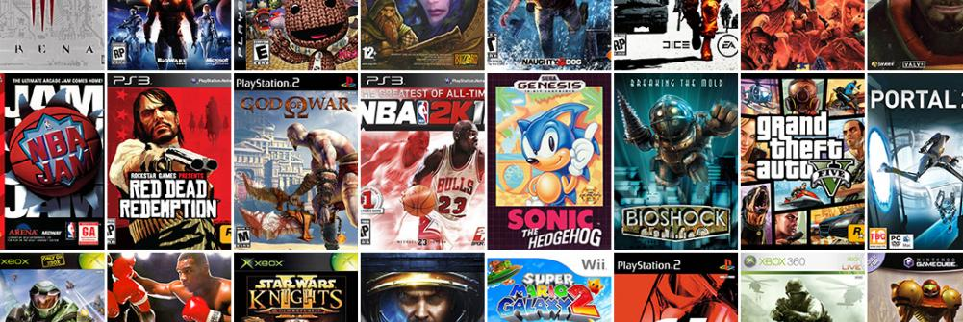
Video Games Technical legal and economic challanges
Covered topics:
Video games as software
Economic rights
Right of publicity.
Notes:
https://www.gamerswithjobs.com/files/styles/front_page_feature/public/images/forum/best-video-games-ever.jpg?itok=NPC99Ckw

Slide 3
Video games as works in practise
Game engine
Interface

Slide 4
Development of video games
Notes:
https://image.slidesharecdn.com/introduction-to-game-development-151205195513-lva1-app6892/95/introduction-to-game-development-11-638.jpg?cb=1449345403

Slide 5
Changes in the way of dissemination
(Console Manufacturer),
Developer,
Publisher,
Retailer,
Consumer.
Notes:
https://sm.ign.com/ign_hu/screenshot/default/creative_bmpd.png
https://gamepod.hu/dl/cnt/2011-07/74469/sega_logo.png

Slide 6
“Off-the-shelf”
Physical Data Carriers (Floppy, CD, DVD, Blu-ray),
Reduced from 80% to 69% (2009-2011).
Steam (Valve), Origin (EA), Ubisoft Club,
Digital Distribution Platforms (Steam),
125 Million users in November 2015 (Steam),
4.500 games, 400 Million user generated content (Steam),
1,5 Billion Dollars profit (Steam).

Slide 7
Pro & contra
“Eternal” place in the “Cloud”,
Cut out the retailer,
Sparing money on packing and delivery,
Social Gaming, User Generated Contents,
Attractive and effective against Piracy.
Hard to collect,
Malfunction could lead to content-loss,
Limited hardware drive storage capacities,
Resistance from retailers,
Fear of low payment and personal data security.

Slide 8
How does DIGITAL Distribution protect?
Internet is the most natural channel for distributing digital products.
Reasons and disadvantages of piracy:
Fast, cheap, unlimited, BUT illegal.
Advantages of Digital Distribution:
Fast, cheaper than the traditional distribution, more and more legal content, permanent patches and updates,
It could reduce the second hand software market.

Slide 9
Paying with cryptocurrency and streaming the episodes of computergames
Bitcoin and other virtual currencies,
Streaming the Episodes of Computer Games.
Notes:
https://upload.wikimedia.org/wikipedia/commons/f/f2/Origin.svg
https://sm.ign.com/ign_hu/screenshot/default/apx5ui9vstyg4md6sxi0_nhhg.jpg

Slide 10
Thank you for your attention
Harkai István (harkai.istvan89@gmail.com; harkai.istvan@juris.u-szeged.hu)
Blog: Copy 21 (http://copy21.com/).
This teaching material has been made at the University of Szeged, and supported by the European Union by the project nr. EFOP-3.6.2-16-2017-00007, titled Aspects on the development of intelligent, sustainable and inclusive society: social, technological, innovation networks in employment and digital economy. The project has been supported by the European Union, co-financed by the European Social Fund and the budget of Hungary.

