Slide 1
The regional labour market differences in Central-Eastern Europe
Katalin LIPTÁK
assistant lecturer
University of Miskolc,
Hungary
Faculty of Economics,
Institute of World- and Regional Economics
„The described work was carried out as part of the TÁMOP-4.2.2/B-10/1-2010-0008 project in the framework of the New Hungarian Development Plan. The realization of this project is supported by the European Union, co-financed by the European Social Fund.”

Slide 2
Research questions
The three research questions the paper attempts to answer are:
What are the main labour market trends in the CEE regions?
What kind of relationship can be observed in Okun's law based on the unemployment rate and output gap at the national and regional level? Does the Okun’s law valid in this regions?
What kind of forecast model could give trusted results?

Slide 3
Hypotesis
Hyothesis 1: Hoover index suggests that the trend observed in the regional equalization of population and the number of employees in East-Central European countries contradicts that in the Western countries.
4
Notes:
I had analyzed the Okun’s law in the Central-Eastern European countries and I tried to find the answer that all countries are valid the Okun’s law or not and how changes the output gap and the natural unemployment rate.
I have chosen the analysis of the labour market situation by the transition economies in particular the last twenty years and the world economic crisis (2008) because they have been more and more used in the economy and can be considered an actual question.

Slide 4
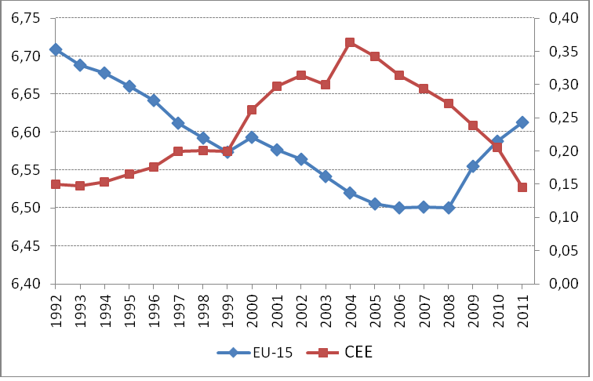
Evolution of Hoover index
Source: Own work based on Worldbank data

Slide 5
Unemployment rate (%) between 1996 and 2010
Source: Own compilation on the basis of Eurostat data
11
Notes:
The evolution of the unemployment rate well illustrates the process of the regime change. The most hectic are the Slovakian and Polish curves that showed a 15% drawback by the year 2008. The unemployment rate data of Hungary, Slovenia and Czech Republic moved together in each period, although its opposite would have been expected in the light of the GDP figures. Estonia, Latvia and Lithuania travelled on different routes, their rates of unemployment continuously decreased after the change of regime; they not only completed the regime change fast and efficiently but were also able to treat the suddenly appearing unemployment efficiently. The economic world crisis commencing in the Autumn of 2008 could be instantly felt in the labour market as well; most of the states were unable to get out of the deep recession, although they introduced significant employment policy measures. For example, in Hungary the public employment programs became dominant (Way to Work Program) to treat the problem, however, unfortunately, they did not lead to permanent results. Unemployment struck Latvia the most severely.

Slide 6
Employment rate (%) between 1996 and 2010
Source: Own compilation on the basis of Eurostat data
12
Notes:
The regime changing countries in question can be categorised into two groups in terms of the rate of employment: Poland, Slovakia and Hungary possessed lower levels of employment; whereas the rest of the countries got into higher categories. Studying the Estonian employment policy could be a separate topic; they could reach the employment level of 70% as set out by the Lisbon Strategy, however, the crisis struck them as well and it broke the fast growing trend.

Slide 7
Length of recession in the CEE countries (% change on previous quarter)
 | 2007Q3 | 2007Q4 | 2008Q1 | 2008Q2 | 2008Q3 | 2008Q4 | 2009Q1 | 2009Q2 | 2009Q3 | 2009Q4 | 2010Q1 | 2010Q2 | 2010Q3
Czech Republic | 1.3 | 1.0 | 0.3 | 0.7 | 0.2 | -0.9 | -3.6 | -0.5 | 0.5 | 0.4 | 0.6 | 0.8 | 1.0
Estonia | 0.4 | 0.4 | -2.2 | -1.0 | -2.6 | -5.7 | -5.6 | -3.7 | -1.3 | 1.4 | 1.0 | 1.9 | 0.7
Hungary | 0.3 | 0.6 | 1.2 | -0.2 | -1.0 | -2.1 | -3.2 | -1.3 | -0.8 | 0.1 | 1.4 | 0.2 | 0.6
Latvia | 1.9 | 0.9 | -3.0 | -1.8 | -1.8 | -4.0 | -11.3 | -1.3 | -4.2 | -0.6 | 1.0 | 1.2 | 0.9
Lithuania | 3.4 | 0.3 | 1.0 | 0.4 | -1.8 | -1.2 | -11.5 | -2.1 | -0.1 | -1.1 | 1.4 | 1.0 | 0.3
Poland | 1.3 | 2.2 | 1.4 | 0.7 | 0.8 | -0.4 | 0.4 | 0.6 | 0.4 | 1.4 | 0.7 | 1.2 | 1.3
Slovakia | 2.5 | 5.2 | -1.4 | 1.0 | 1.2 | 0.6 | -7.6 | 1.1 | 1.2 | 1.4 | 0.7 | 0.9 | 0.9
Slovenia | 2.0 | 0.8 | 1.7 | 0.7 | 0.2 | -3.3 | -6.0 | -0.6 | 0.4 | 0.1 | -0.1 | 1.0 | 0.3
Source: Own compilation on the basis of Eurostat data
15
Notes:
The effect of the global economic crisis has been perceptible in Central Eastern Europe, too. The length of the crisis is characterized by the increase of per capita GDP by quarters. They have been the Baltic countries and Hungary that were affected by the crisis for the longer time and to the greatest extent.
After the world economic crisis was in the worst position the Baltic countries, but the employment growth rate in 2010 quarter 4. has increased.

Slide 8
Thesis
Thesis 1: Labour market competition has intensifying since the expansion of the European Union in 2004, while an apparent equalization is taking place in East-Central European countries; however this equalization is not coupled with convergence it rather results in a joint divergence.

Slide 9
Hypothesis
Hyothesis 2: The function-like relationship between the output gap and the unemployment rate (Okun's Law) is true at national levels; however, significant differences emerge compared with the theoretical model in the case of regions.

Slide 10
Definition of Okun’s law
“Okun's law postulates a negative relationship between movements of the unemployment rate and the real gross domestic product (GDP).” (Sänger – Stiassny, 2000:3)
“Typically, growth slowdowns coincide with rising unemployment. This negative correlation between GDP growth and unemployment has been named Okun’s law, after the economist Arthur Okun who first documented it in the early 1960s.” (Knotek, 2007:73)
According to the Okun’s law every ca. 2% rising GDP compared to the potential GDP causes 1% unemployment growth.
17

Slide 11
The Okun’s law in the CEE countries (1996-2010)
 | Okun’s law | output gap (if the unemployment rate is zero) | natural unemployment rate (if the output gap is zero) | natural unemployment rate (if the output gap is - 2%)
Czech Republic | x= - 1.853u+13.328 | 13.328 | 7.193 | 6.113
Estonia | x= - 1.958u+19.207 | 19.207 | 9.809 | 10.083
Latvia | x= - 1.740u+20.057 | 20.057 | 11.527 | 12.676
Lithuania | x= - 1.451u+16.646 | 16.646 | 11.472 | 12.850
Hungary | x= - 2.061u+15.570 | 15.570 | 7.555 | 8.525
Poland | x= - 0.582u+8.107 | 8.107 | 13.930 | 17.367
Slovenia | x= - 2.969u+18.820 | 18.820 | 6.339 | 7.012
Slovakia | x= - 1.218u+18.603 | 18.603 | 15.273 | 16.915
Source: own compilation
21
Notes:
We could observe that the Okun’s coefficient is ca. 2% except Poland (0.582). If the GDP decreases ca. 2% to the potential GDP then the unemployment rate increases 1% to the natural unemployment rate – it is right all CEE countries except Poland. According to my statement the Okun’s law is valid all CEE countries except Poland between 1996 and 2010.

Slide 12
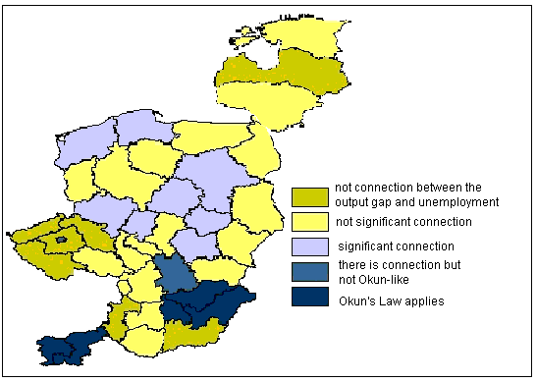
Evolution of Okun's Law in East-Central European Regions
Source: Own work

Slide 13
Thesis
Thesis 2: Okun's Law is true at the level of countries, however it does not apply at regional levels in each case – which means that this connection cannot be used to investigate regional processes with complete confidence. However, "anomalies" can be detected at regional level. The regions can be categorized into three groups:
Okun's Law applies
There is a connection between the unemployment rate and the output gap, however it is not Okun-like (with a 2% decrease of output gap the unemployment rate increases multiple times, approx. 6-10%).
There is no connection between the two indicators.

Slide 14
Hypothesis
Hypothesis 3: a) According to this hypothesis, ARIMA (Auto-Regressive Integrated Moving Average) is a possible method of forecasts that support regional employment policy. Applying the method makes it possible to determine the expected direction and extent of changes in the region's labour market; the prognosis prepared with this forecasting method can provide a guideline for the regional employment policy.
b) The impact of the economic crisis on regional labour market can be demonstrated by comparing the forecasted and actual number of registered job-seekers in Northern Hungary for the period between February 2009 and July 2010.

Slide 15
Prediction of the number of registered unemployed until October 2014
150000
95 percent interval
allaskeresok_sz
Source: Own calculation
140000
forecast
130000
120000
110000
100000
90000
80000
70000
60000
1995
2000
2005
2010
2015

Slide 16
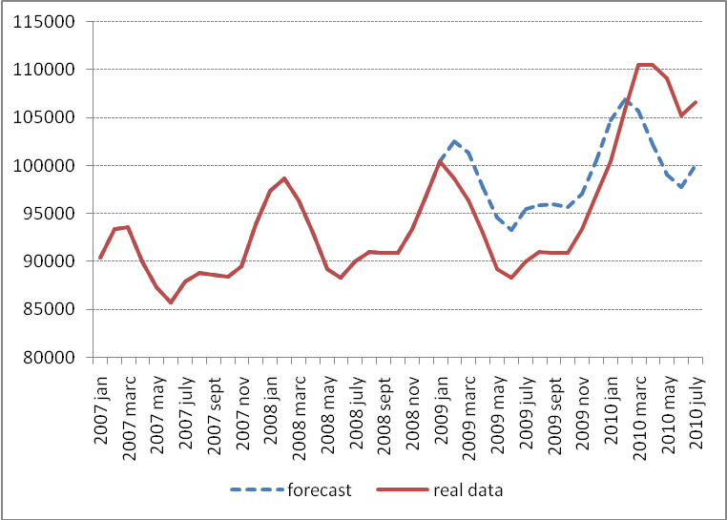
Result of the prediction if the economic crisis had not occurred
Source: Own calculation

Slide 17
Thesis
Thesis 3: a) Having applied ARIMA method to the past-period time series of the number of registered job-seekers it has been proven that the predicted and actual data match at 95% level of confidence. The prognosis prepared for 24 months using that forecasting method predicts a further minor deterioration of the region's employment situation for the regional employment policy.
b) The difference between the prediction of Northern Hungary's registered job-seekers for the 18 months of the crisis and the actual changes prove the existence of the delayed labour market impact (hysteresis).

Slide 18
Recommendations for developing an efficient regional employment policy
A multi-channel employment policy would be reasonable in the long term that combines the traditional forms of employment and alternative solutions.
Regions having similar characteristics and similar labour market features should cooperate and act jointly in the European Union; joint asserting of interests and joint representation would bring significant results.
The flow of sectoral labour force may exert less and less influntial power for regional employment policy in the future.
Regional employment policy should give priority to the supporting of human potential by way of, within the active employment policy tools, increasing the amount spent on labour market trainings; it requires taking the demands and emerging needs of employers.
Various labour market forecasting models are available to support regional employment policy.

Slide 19
Thank you for your attention! liptak.katalin@uni-miskolc.hu

