Slide 1
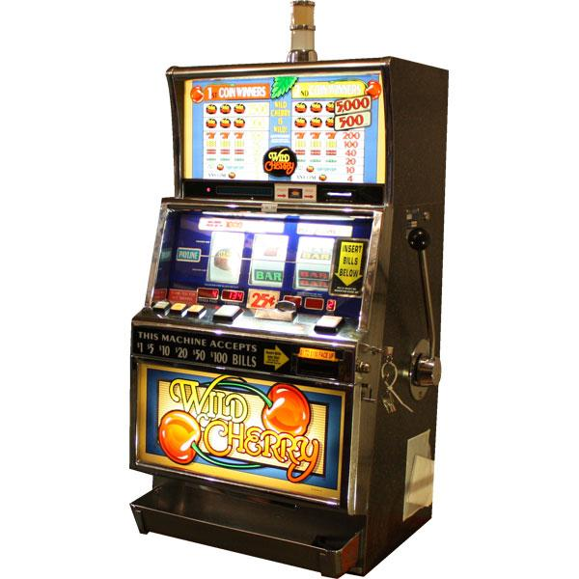
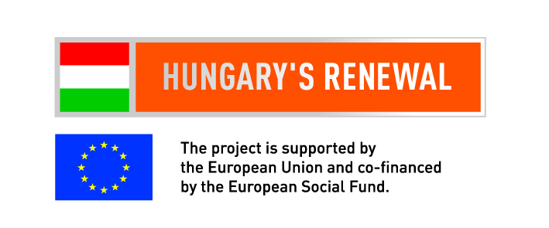
University of Szeged Faculty of economics and Business Administration PhD School in Economics Centre for Economic Psychology
SLOT MACHINES AND ONLINE GAMBLING,
LEGAL AND ILLEGAL GAMBLING ACTORS IN HUNGARY
Judit Tessényi &
Zsolt Ábrahám
16 jun 2012.
Notes:
On the frontier of legitimicy reside the online gambling companies, yet the media is full of their advertisements. Why? How much money does the government lose by companies avoiding taxes, or not paying their taxes in Hungary? Who’s responsibility is it? Why isn’t anyone doing something about this? Did the modification of the Gambling Act in 2011 September brought forth a solution?

Slide 2
content
Situation
Test questions & hypotheses
Research
Results
Conclusions
Notes:
This unimagibly huge industry with dozens of different branches advances almost at the speed of light thanks to the internet, smartphones, poker, international lottary games and being able to bet online on games during the game. Out of all the options, this article will investigate the slot machines and the online gambling’s markets.

Slide 3
The gambling tax by sector distributions from the game-play breakdown in 2010
Notes:
Significantly
The tax increase coming live in 2011 november the first gives the topic a very interesting tone. In regards to the taxes, the authors did a quick survey on the contractors possible reactions in regards to increased costs. Other than describing the current situation, the article will provide possible resolutions to the anomalies occuring on the hungarian gambling market.

Slide 4
The problem
From November 2011th significantly increased the tax on vending machines
H1: „Restaurants will close because of the increase of the gambling taxes”
Four county wide quick surveys were conducted (Bacs-Kiskun, Szolnok, Csongrad, Bekes), first in 2011 October, and then in 2012 February. The aim of the survey was to find out how contractors react to the increase in their tax liabilites.
Notes:
prognosis
„Restaurants, inns and pubs will close because of the increase of the gambling taxes”

Slide 5
examination
The survey reached out to 50 providers, with overall 82 slot machines. Out of the 50, there were 43 pubs with 73 slot machines, because pubs are the most senstive to tax changes.
H2: they may be most sensitive to tax changes ...
Notes:
We have conducted a quick survey in four counties (Bács-Kiskun, Szolnok, Csongrád and Békés) first in 2011 October then again in 2012 february. The survey’s aim was to find out how entrepeneurs will react to the huge increases in taxes and will they come through with their previous statements.

Slide 6
The first responses of the slot machine operators
(A) 37% said to give back the machines,
(B) 19% stated to pay the taxes
(C) the whole business closes because of the extra tax 0%
(D) 30% stated to reduce the number of machines, other analysts note THIS AMOUNTS to 14%
(E) 14% said to wait out
There are overall 50 contractors with 82 slot machines
Notes:
37% of the providers asked based on the number of slot machines stated that they will give back the machine. 30% gave the answer „D” or stated that they will decrease the number of slot machines. Furthemore, on the day of the survey, 19% thought that they will be able to pay the increase in taxes. Mostly most of the companies are optimistic, none of them thought they will go out of business because of the changes in taxes
The answer E, or other comments means that the online (central server) based slot machines are of interest to 14% of the surveyors.

Slide 7
3 month later…
Gave back the slot machines
not reacting, are waiting
still a distributor
reduced the number of slot machines
Notes:
As for the next step, we surveyed the same group in februrary with the same question. The actual reactions greatly swayed from the initial intentions from the first survey, though there are only 3 months difference, lot of them are stuck in the „wait it out” phase.
Those that do stay on the market are waiting and hoping for the implementation of a server based system.

Slide 8
II. Sportingbet on the web
The organization of gambling by the 1991st XXXIV. Law, the state has a monopoly on the organization of betting, but in practice they have monopoly on any gambling organization. The organizers that are offering foreign-owned games are also forbidden to advertise it. However, the illegal foreign betting offices carry out their activities undisturbed in present day Hungary.

Slide 9
Regulatory alternatives
full liberalization
partial liberalization
monopoly, bans
Notes:
The online version of the game was implemented much later, in the June of 2006. This implementation could be identefied as a counter measure to those, foreign based sites that are in hungarian language that offer online sport betting. The hungarian lottery company had to do something, because these illegal online gambling sites offered a larger variety in sports as well as payoffs than the Hungarian Lottery Company.
three different options are viable
complete stop
functional liberalisation, with caution money and tenders
functional liberalisation, the complete income should be taxed

Slide 10
monopoly, bans
any Member State of the EU may prohibit Internet gambling.
The Member State shall also have the right to grant exclusive rights to Online Gambling.
Partial liberalization
contest
taxation
Notes:
For example: In the United States there is a complete stop on online gambling for foreign companies
In the first case, the state taxes the gross income of the participants (regardless of the expenditures of the firms and the amount of prices payed out)
In the second case, companies will pay their taxes based on the difference between income and payed out prices.

Slide 11
the explosion is expected to change the access to the games
The more you will be something they will reproduce the possibilities of access to illegal games
tax evasion
extra profit
Notes:
The benefit of this solution is that free market competitiveness gains ground on the matter and only the best can stay in business. Taking out the registration process, barriers of entry are lower. Consumers can benefit from this as well, they can enjoy betting in a legal fashion from foreign online gambling sites.
In Hungary the parliament passed legislation on the modification of the Gambling Act. The new regulation corrected a lot of things in the system (permits, online bets, horse races betting, poker, taxes), however regulations on sport betting is still not covered.
A lot of companies are in trouble because of the new legislation, even though some of their activities are now legal, their sport betting

Slide 12
Conclusions
Slot Machines
H1: False, none closed down, some decreased the number of slot machones, most wait out.
H2: They are,however because of the increased number of costumers, they are able to pay it off.

Slide 13
Conclusions
Online Gambling
The government has three viable options
Even the illegal entities want a transparent regulatory system
Huge potential benefit for the Hungarian government -> NEED FOR REGULATION!

Slide 14
Game on…
The publication/presentation is supported by the European Union and co-funded by the European Social Fund.
Project title: “Broadening the knowledge base and supporting the long term professional sustainability of the Research University Centre of Excellence at the University of Szeged by ensuring the rising generation of excellent scientists.”
Project number: TÁMOP-4.2.2/B-10/1-2010-0012
Notes:
When someone says 'Game on!', it means that they are accepting a challenge or ready to get something done.

