Slide 1
Introduction to the Comparative Entertainment Law
Dr. István Harkai PhD, Assistant Lecturer
University of Szeged Faculty of Law and Political Sciences
Institute of Comparative Law and Legal Theory

Slide 2
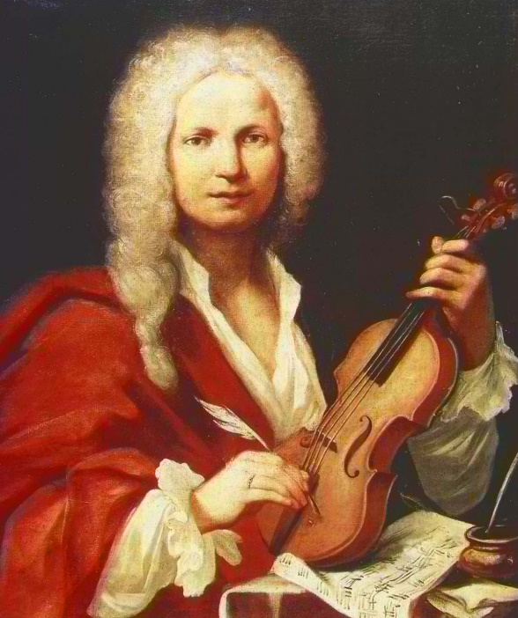
Actors of the creative industry Comparative Perspective
Notes:
https://hu.wikipedia.org/wiki/Antonio_Vivaldi#/media/F%C3%A1jl:Vivaldi.jpg

Slide 3
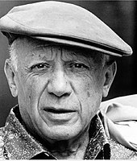
Authors
Who is an author?
Creator of the work (sweat of the brow).
How long is a work protected? LIFE+70
Notes:
https://karrierologia.com/wp-content/uploads/2017/07/jk-rowling-harry-potter.jpg
https://upload.wikimedia.org/wikipedia/commons/thumb/9/98/Pablo_picasso_1.jpg/170px-Pablo_picasso_1.jpg
https://image.cnbcfm.com/api/v1/image/103909159-GettyImages-3230586.jpg?v=1574111209&w=900&h=506

Slide 4
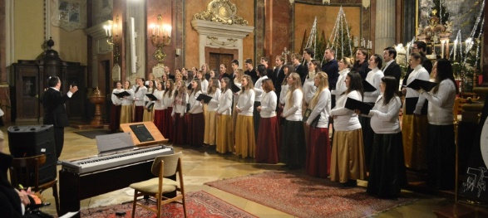
Rights related to copyright
Holders of related rights (neighbouring rights): facilitating the dissemination of copyright protected goods.
Not works but other achievements.
Protection of performers: interpreting works to the public.
Notes:
https://www.aurin-choir.hu/wp-content/uploads/2019/02/nyito_vegyes.jpg

Slide 5
Rights related to copyright
Phonogram producers,
Radio and television organisations,
Film producers.
Notes:
https://sites.google.com/site/kartundisniy55/_/rsrc/1468750605100/config/customLogo.gif?revision=1
https://hu.wikipedia.org/wiki/EMI#/media/F%C3%A1jl:EMI_logo.svg
https://www.universalmusic.com/wp-content/uploads/2015/09/universal-music-group-logo.png
https://amerikaimesek.hu/wp-content/uploads/2019/03/warner_bros-_pictures_intro-700x467.jpg

Slide 6
Thank you for your attention
Harkai István (harkai.istvan89@gmail.com; harkai.istvan@juris.u-szeged.hu)
Blog: Copy 21 (http://copy21.com/).
This teaching material has been made at the University of Szeged, and supported by the European Union by the project nr. EFOP-3.6.2-16-2017-00007, titled Aspects on the development of intelligent, sustainable and inclusive society: social, technological, innovation networks in employment and digital economy. The project has been supported by the European Union, co-financed by the European Social Fund and the budget of Hungary.

